Slide 1

Math’s 14
Optimisation problems

Slide 2
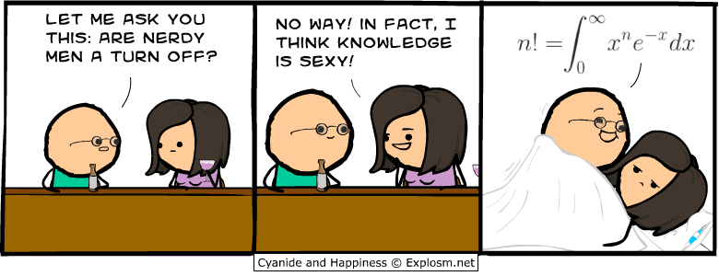
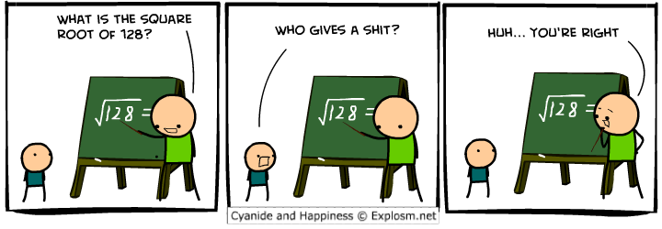
Optimisation

Slide 3
Partial Derivative
Up to now we have been dealing with functions that only have one variable in it. Ie everything is a function of x.
But what happens if we have a function with 2 or more variables?

Slide 4
Partial Derivative
So what happens if we have a function with:
x² + y² +2x – 3y

Slide 5
Partial Derivative
So what happens if we have a function with:
x² + y² +2x – 3y
Well we can do derivatives with these using the partial derivative method

Slide 6
Partial Derivative
So what happens if we have a function with:
x² + y² +2x – 3y
Well we can do derivatives with these using the partial derivative method
Essentially all you do is derive one variable at a time treating the other as a constant.

Slide 7
Partial Derivative
So what happens if we have a function with:
x² + y² +2x – 3y
Essentially all you do is derive one variable at a time treating the other as a constant.
This gives you the change in one variable while the other is held constant.

Slide 8
Partial Derivative
So what happens if we have a function with:
x² + y² +2x – 3y
This gives you the change in one variable while the other is held constant.
To imagine this think of a can of coke. If you are varying the width of the can trying out different widths it is often best to keep the height constant.

Slide 9
Partial Derivative
So what happens if we have a function with:
x² + k +2x – K
This gives you the change in one variable while the other is held constant.

Slide 10
Partial Derivative
So what happens if we have a function with:
2x + 2
This gives you the change in one variable while the other is held constant.
So the change of x when Y is constant is 2x + 2

Slide 11
Partial Derivative
So what happens if we have a function with:
2x + 2
This gives you the change in one variable while the other is held constant.
So the change of x when Y is constant is 2x + 2
Now do Y

Slide 12
Partial Derivative
So what happens if we have a function with:
K + y² + K – 3y
This gives you the change in one variable while the other is held constant.

Slide 13
Partial Derivative
So what happens if we have a function with:
2y – 3
This gives you the change in one variable while the other is held constant.
And here is the change in y when x is kept constant.
Simple as that.

Slide 14
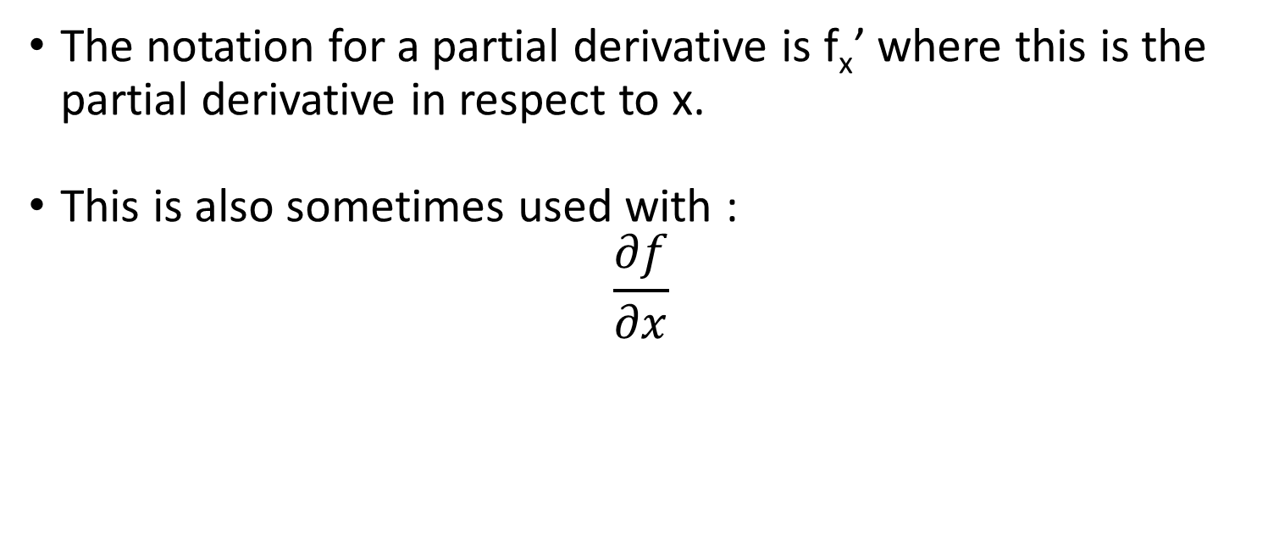
Partial Derivative
The notation for a partial derivative is f_{x}’ where this is the partial derivative in respect to x.
This is also sometimes used with :
$$\frac{∂f}{∂x}$$

Slide 15
Multiple Integrals
So we have derived a function with multiple variables but what about if we need to integrate it?
Well similar steps are taken.

Slide 16
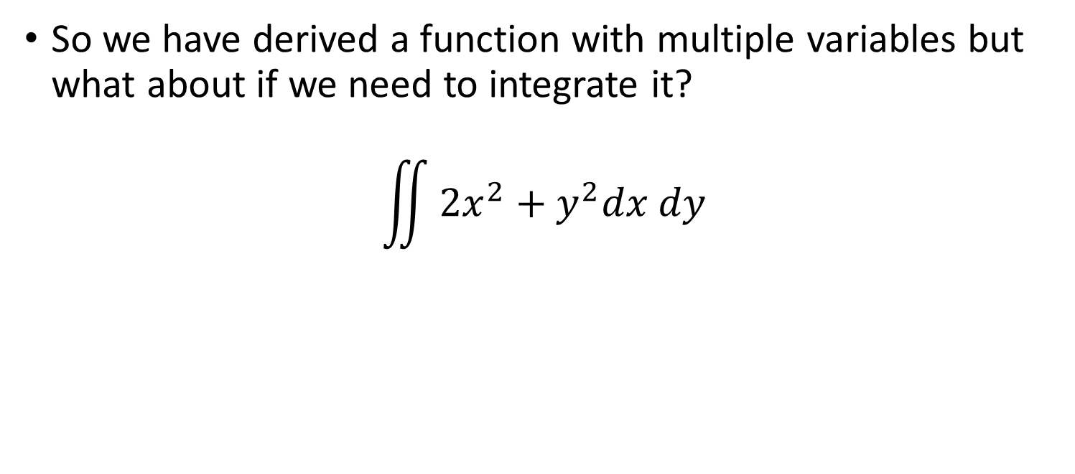
Multiple Integrals
So we have derived a function with multiple variables but what about if we need to integrate it?
$$\iint{{2x}^{2}+y^{2}dx dy}$$

Slide 17
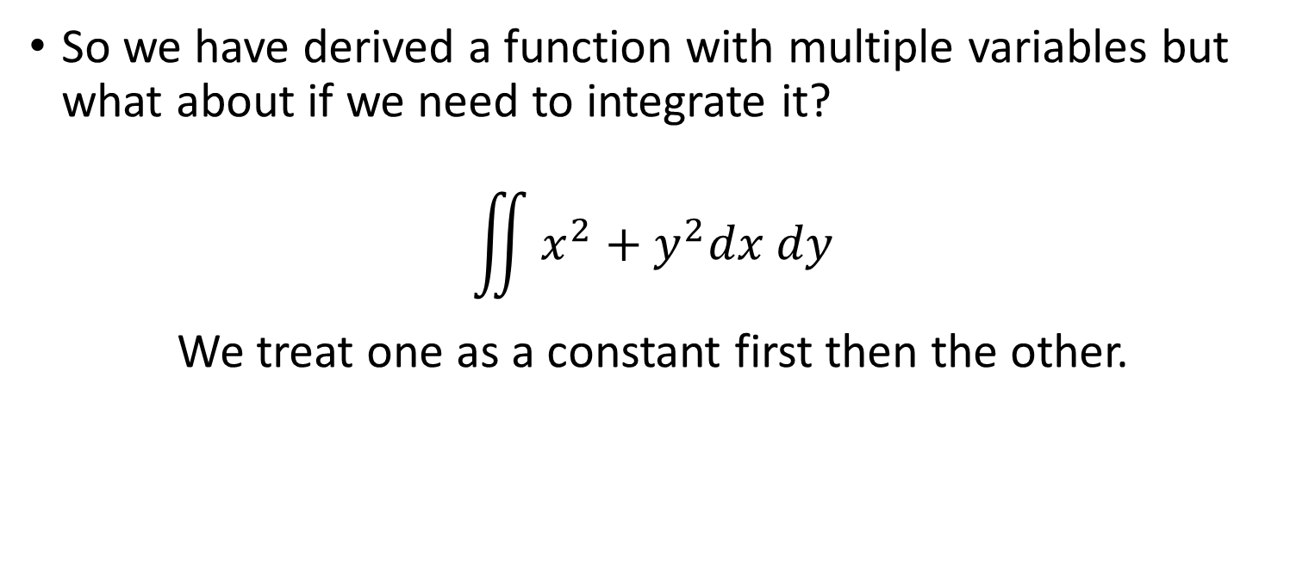
Multiple Integrals
So we have derived a function with multiple variables but what about if we need to integrate it?
$$\iint{x^{2}+y^{2}dx dy}$$
We treat one as a constant first then the other.

Slide 18
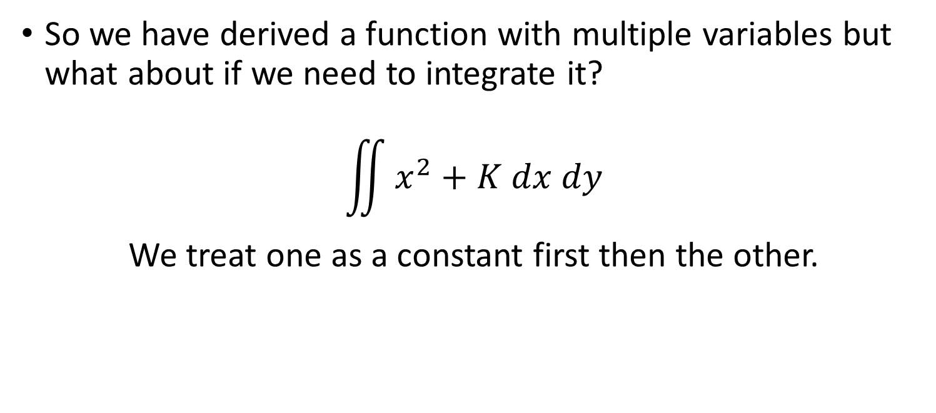
Multiple Integrals
So we have derived a function with multiple variables but what about if we need to integrate it?
$$\iint{x^{2}+K dx dy}$$
We treat one as a constant first then the other.

Slide 19
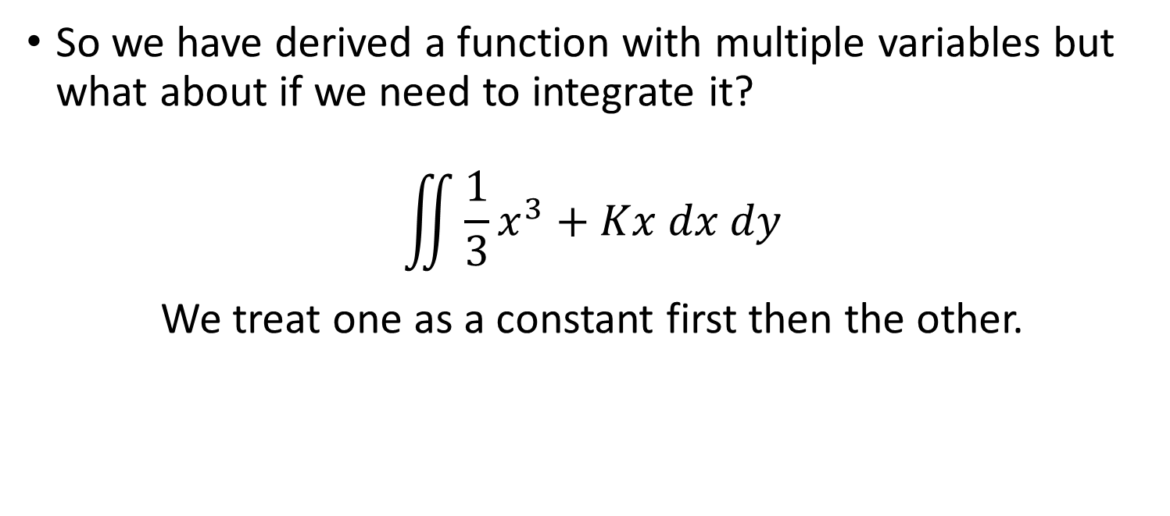
Multiple Integrals
So we have derived a function with multiple variables but what about if we need to integrate it?
$$\iint{{\frac{1}{3}x}^{3}+Kx dx dy}$$
We treat one as a constant first then the other.

Slide 20
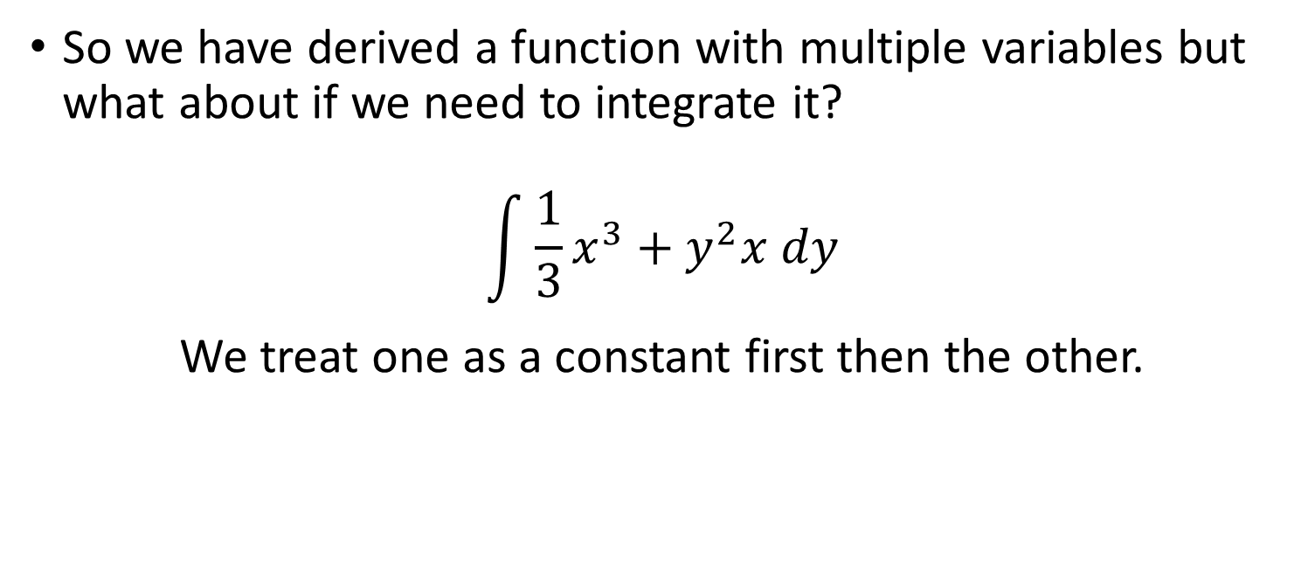
Multiple Integrals
So we have derived a function with multiple variables but what about if we need to integrate it?
$$\int{{\frac{1}{3}x}^{3}+y^{2}x dy}$$
We treat one as a constant first then the other.

Slide 21
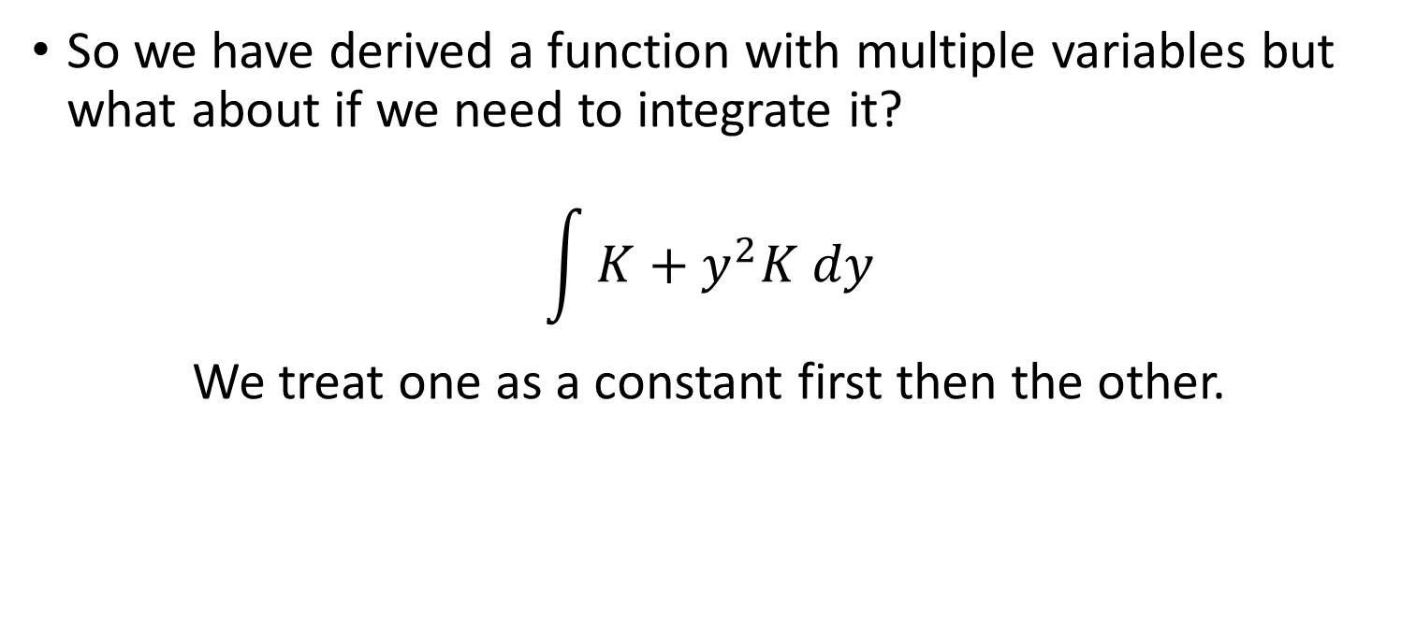
Multiple Integrals
So we have derived a function with multiple variables but what about if we need to integrate it?
$$\int{K+y^{2}K dy}$$
We treat one as a constant first then the other.

Slide 22
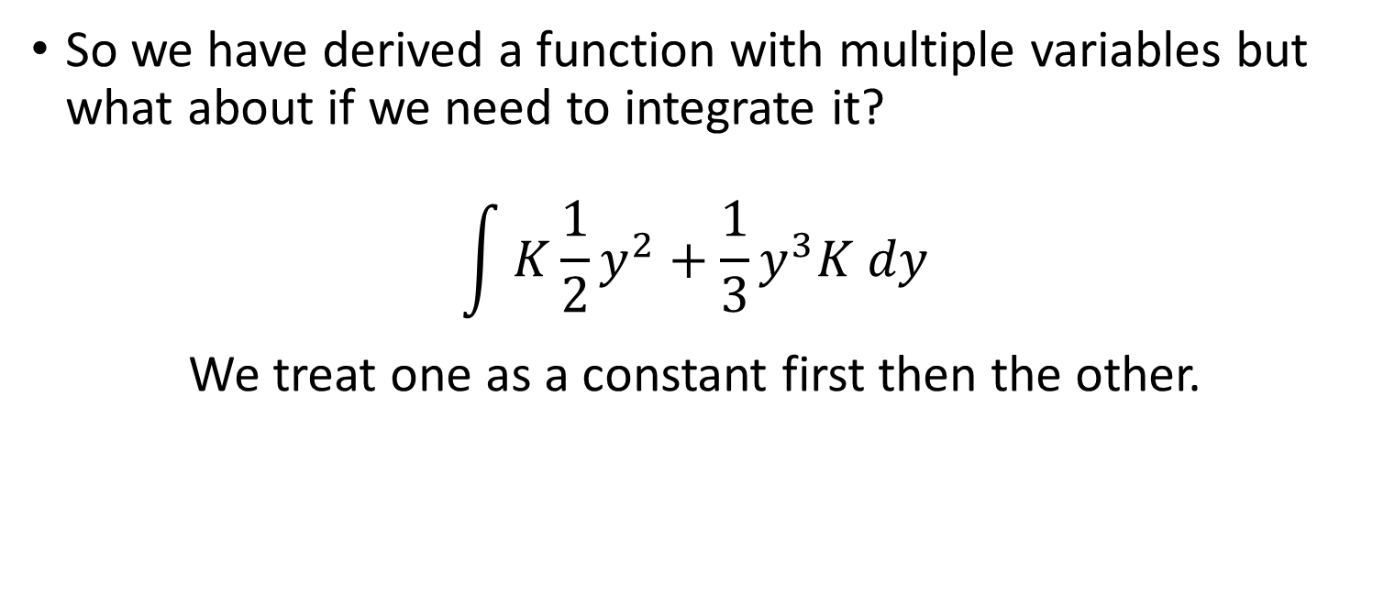
Multiple Integrals
So we have derived a function with multiple variables but what about if we need to integrate it?
$$\int{K\frac{1}{2}y^{2}+{\frac{1}{3}y}^{3}K dy}$$
We treat one as a constant first then the other.

Slide 23
Multiple Integrals
So we have derived a function with multiple variables but what about if we need to integrate it?
$$\int{K\frac{1}{2}y^{2}+{\frac{1}{3}y}^{3}K dy}$$
We treat one as a constant first then the other.

Slide 24
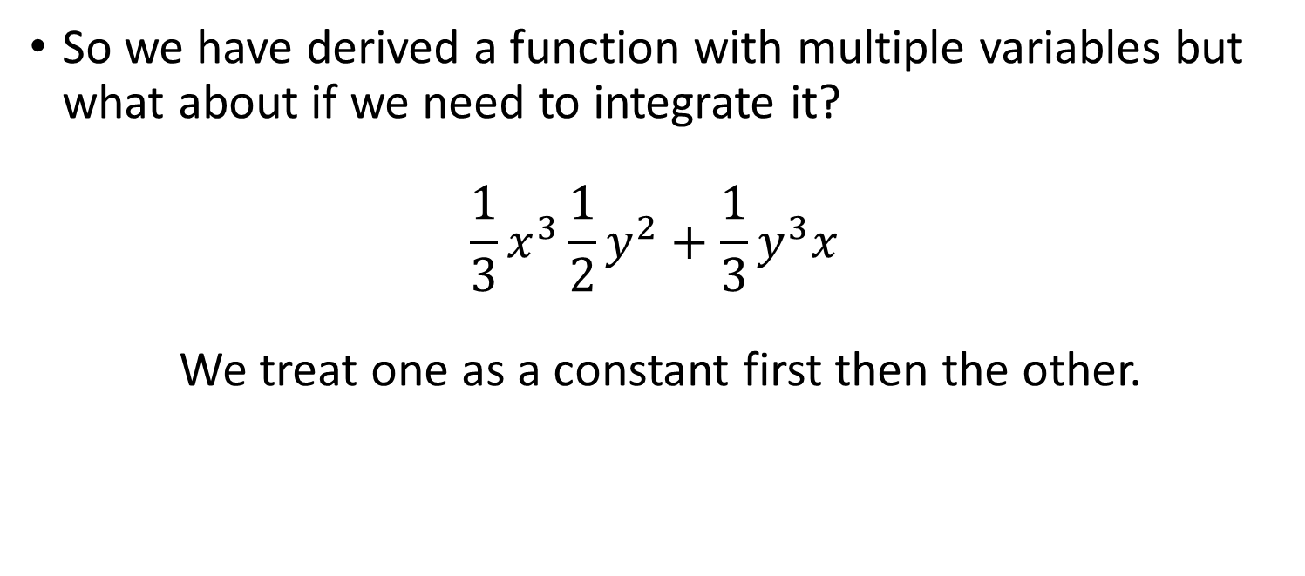
Multiple Integrals
So we have derived a function with multiple variables but what about if we need to integrate it?
$${\frac{1}{3}x}^{3}\frac{1}{2}y^{2}+{\frac{1}{3}y}^{3}x$$
We treat one as a constant first then the other.

Slide 25
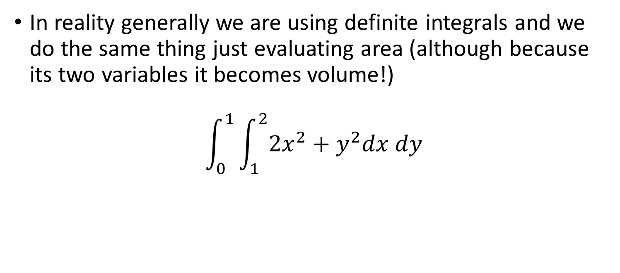
Multiple Integrals
In reality generally we are using definite integrals and we do the same thing just evaluating area (although because its two variables it becomes volume!)
$$\int_{0}^{1}{\int_{1}^{2}{{2x}^{2}+y^{2}dx dy}}$$

Slide 26
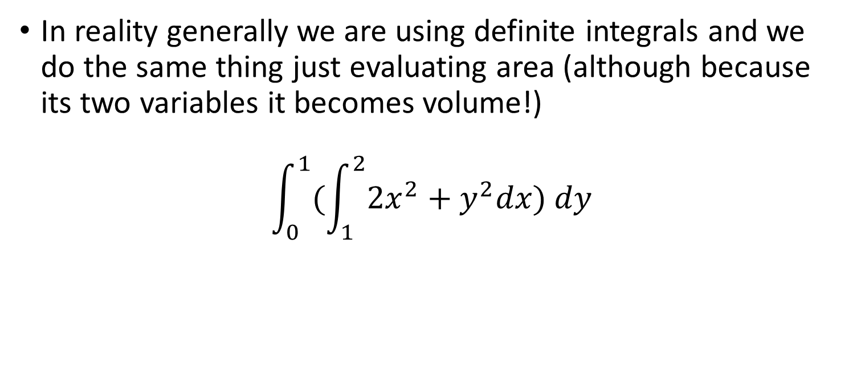
Multiple Integrals
In reality generally we are using definite integrals and we do the same thing just evaluating area (although because its two variables it becomes volume!)
$$\int_{0}^{1}{(\int_{1}^{2}{{2x}^{2}+y^{2}dx) dy}}$$

Slide 27
Multiple Integrals
In reality generally we are using definite integrals and we do the same thing just evaluating area (although because its two variables it becomes volume!)
$$\int_{0}^{1}{(\int_{1}^{2}{{2x}^{2}+y^{2}dx) dy}}$$

Slide 28
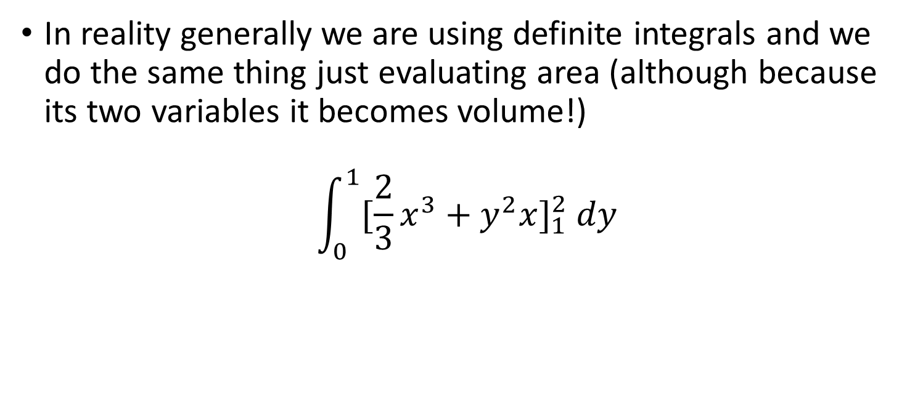
Multiple Integrals
In reality generally we are using definite integrals and we do the same thing just evaluating area (although because its two variables it becomes volume!)
$$\int_{0}^{1}{{[{\frac{2}{3}x}^{3}+y^{2}x]}_{1}^{2} dy}$$

Slide 29
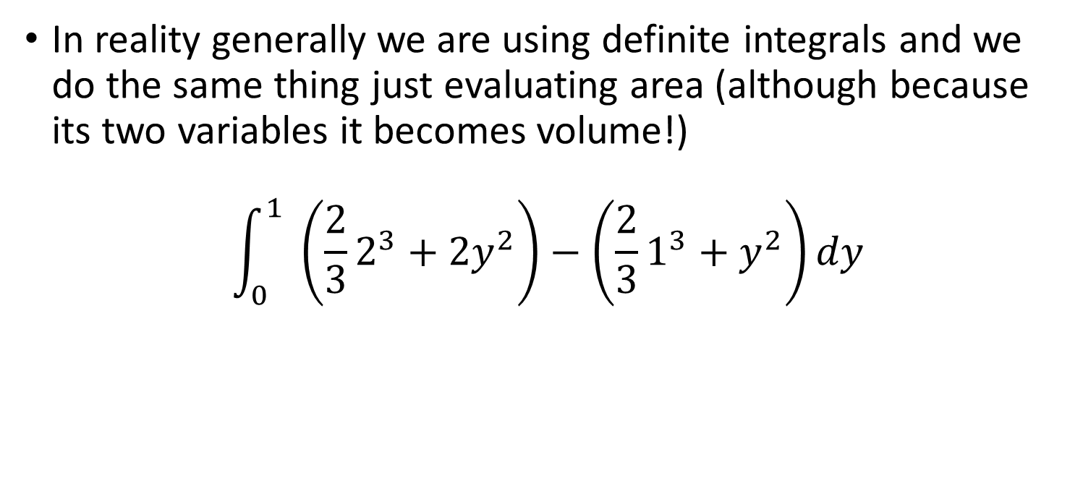
Multiple Integrals
In reality generally we are using definite integrals and we do the same thing just evaluating area (although because its two variables it becomes volume!)
$$\int_{0}^{1}{ \left({\frac{2}{3}2}^{3}+{2y}^{2}\right)−\left({\frac{2}{3}1}^{3}+y^{2}\right)dy}$$

Slide 30
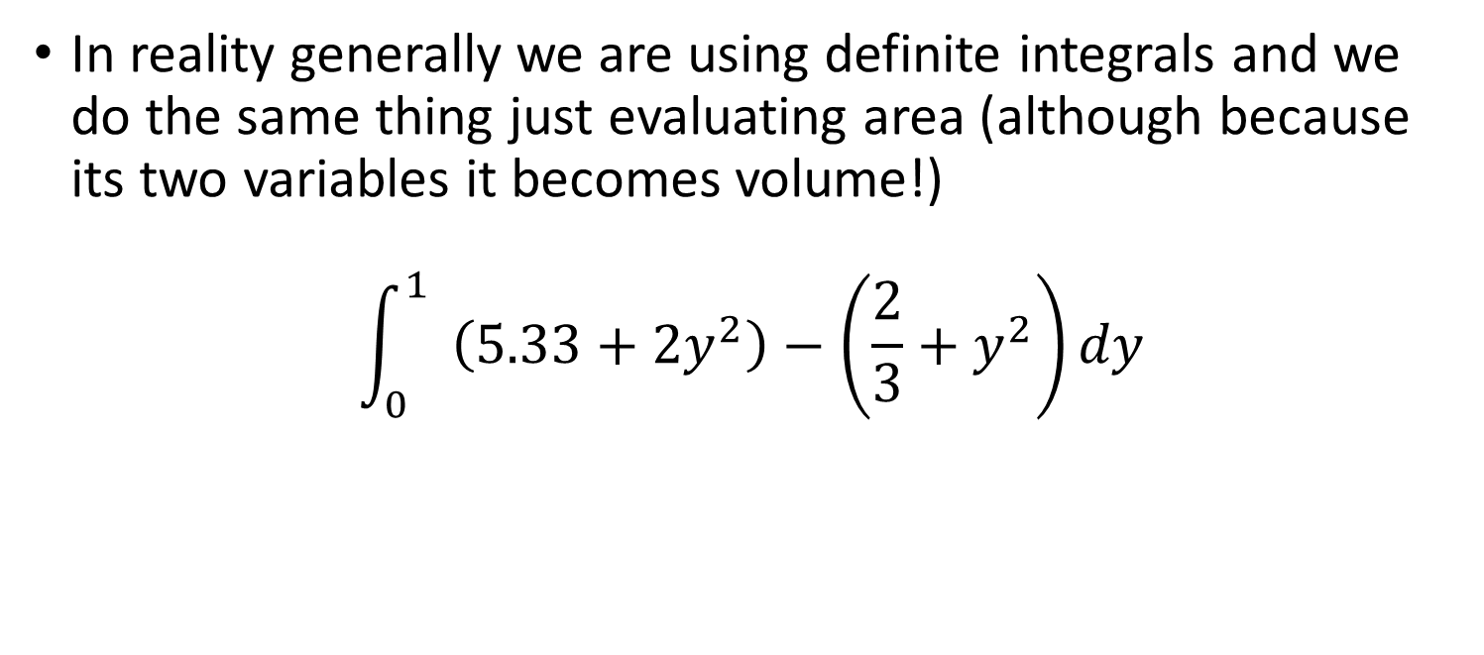
Multiple Integrals
In reality generally we are using definite integrals and we do the same thing just evaluating area (although because its two variables it becomes volume!)
$$\int_{0}^{1}{ \left(5.33+{2y}^{2}\right)−\left(\frac{2}{3}+y^{2}\right)dy}$$

Slide 31
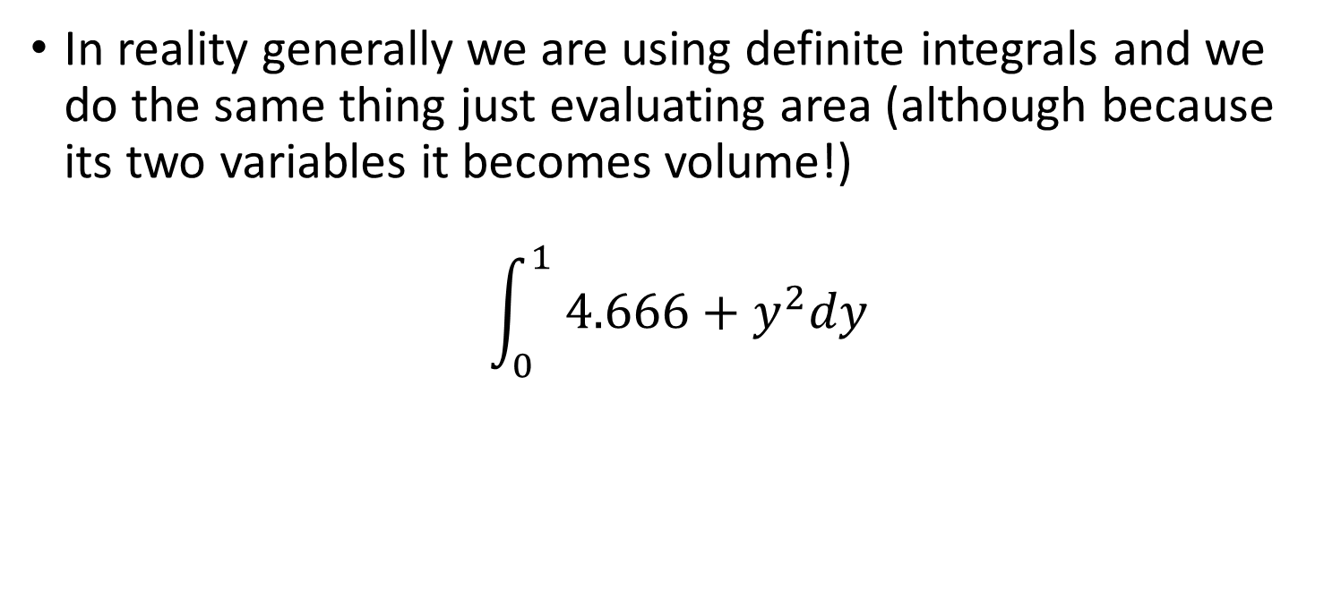
Multiple Integrals
In reality generally we are using definite integrals and we do the same thing just evaluating area (although because its two variables it becomes volume!)
$$\int_{0}^{1}{ 4.666+y^{2}dy}$$

Slide 32
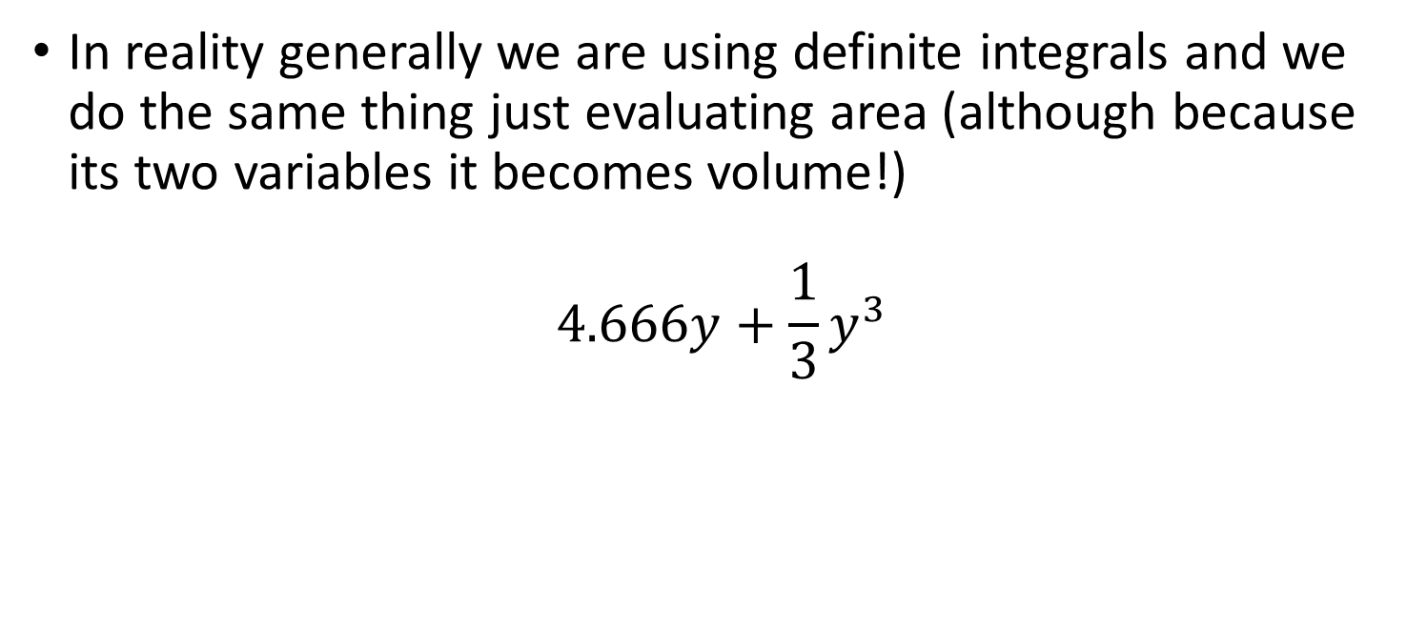
Multiple Integrals
In reality generally we are using definite integrals and we do the same thing just evaluating area (although because its two variables it becomes volume!)
$$4.666y+{\frac{1}{3}y}^{3}$$

Slide 33
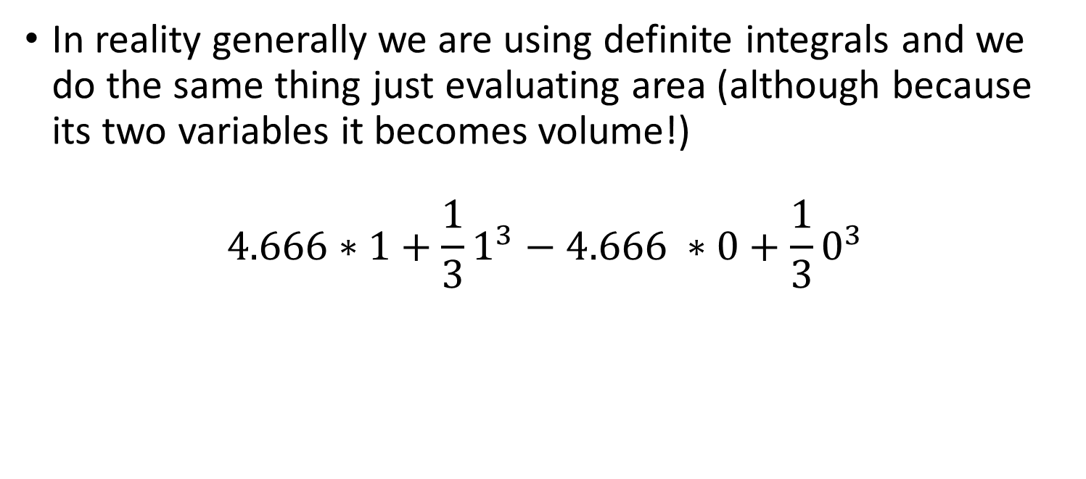
Multiple Integrals
In reality generally we are using definite integrals and we do the same thing just evaluating area (although because its two variables it becomes volume!)
$$4.666∗1+{\frac{1}{3}1}^{3}−4.666 ∗0+\frac{1}{3}0^{3}$$

Slide 34

Multiple Integrals
In reality generally we are using definite integrals and we do the same thing just evaluating area (although because its two variables it becomes volume!)
$$=5$$

Slide 35
Optimisation
Often one of the most useful parts of calculus is optimisation of functions.
When you have multiple variables finding the point that optimises all of them is a tool that is widespread within science and industry.

Slide 36
Optimisation
We have previously used calculus to find where a minimum or a maximum of a function is.
This is optimisation of a function with a single variable.
Things get more tricky when you have to find the optimal point for multiple variables, often the best point for one is not the same as the other.

Slide 37
Optimisation
Finding the stationary points as we did using the derivative is the first step.
But we need to find a point that maximises both of the variables.
It could be finding the points of 1 variable that maximises another under some constraint etc.

Slide 38
Optimisation
If I have a can of drink that has to contain 330ml of fluid.
I want to save money by using a little metal as possible right?
So I should design my can with dimensions that use as little metal as possible.

Slide 39
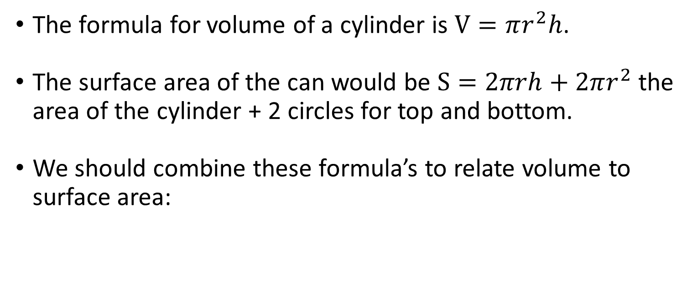
Optimisation - Can
The formula for volume of a cylinder is $V=πr^{2}h$.
The surface area of the can would be $S=2πrh+2πr^{2}$ the area of the cylinder + 2 circles for top and bottom.
We should combine these formula’s to relate volume to surface area:

Slide 40

Optimisation - Can
The formula for volume of a cylinder is $V=πr^{2}h$.
So $h=\frac{V}{πr^{2}}$
Put this into $S=2πrh+2πr^{2}$
$S=2πr\frac{V}{πr^{2}}+2πr^{2}$

Slide 41

Optimisation - Can
The formula for volume of a cylinder is $V=πr^{2}h$.
So $h=\frac{V}{πr^{2}}$
Put this into $S=2πrh+2πr^{2}$
$S=2vr^{−1}+2πr^{2}$

Slide 42
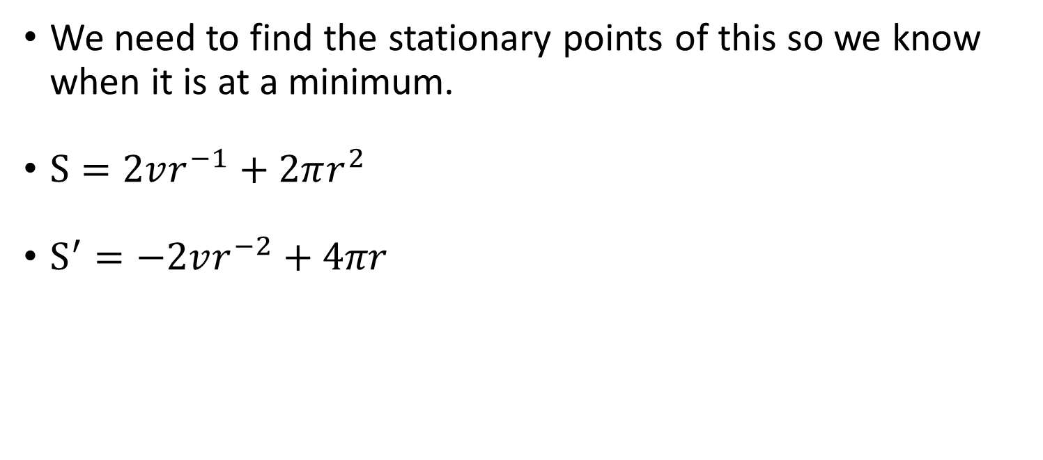
Optimisation - Can
We need to find the stationary points of this so we know when it is at a minimum.
$S=2vr^{−1}+2πr^{2}$
$S^{′}=−2vr^{−2}+4πr$

Slide 43
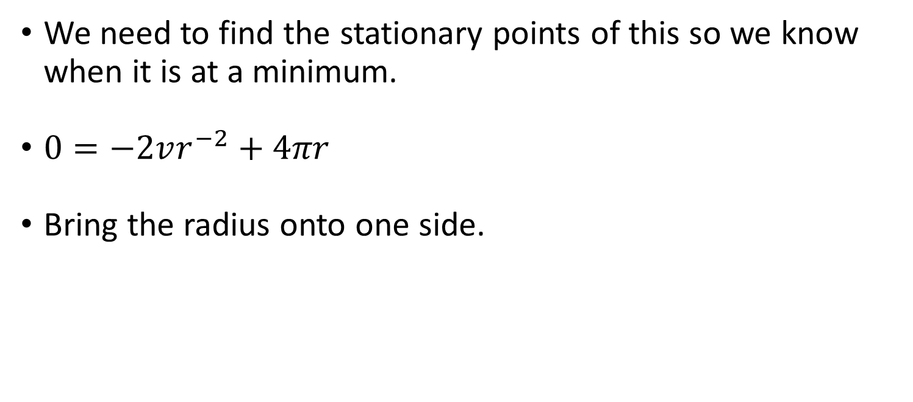
Optimisation - Can
We need to find the stationary points of this so we know when it is at a minimum.
$0=−2vr^{−2}+4πr$
Bring the radius onto one side.

Slide 44
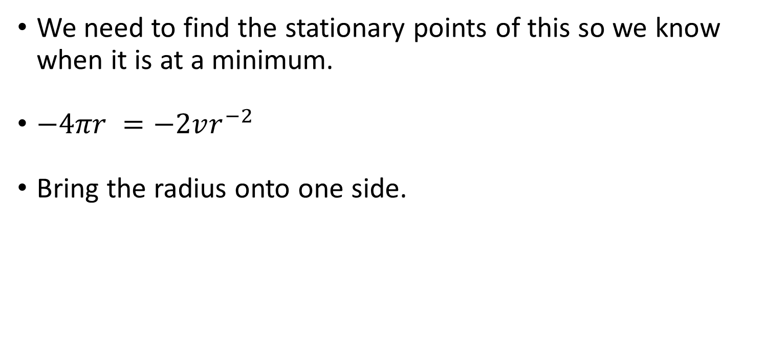
Optimisation - Can
We need to find the stationary points of this so we know when it is at a minimum.
$−4πr =−2vr^{−2}$
Bring the radius onto one side.

Slide 45
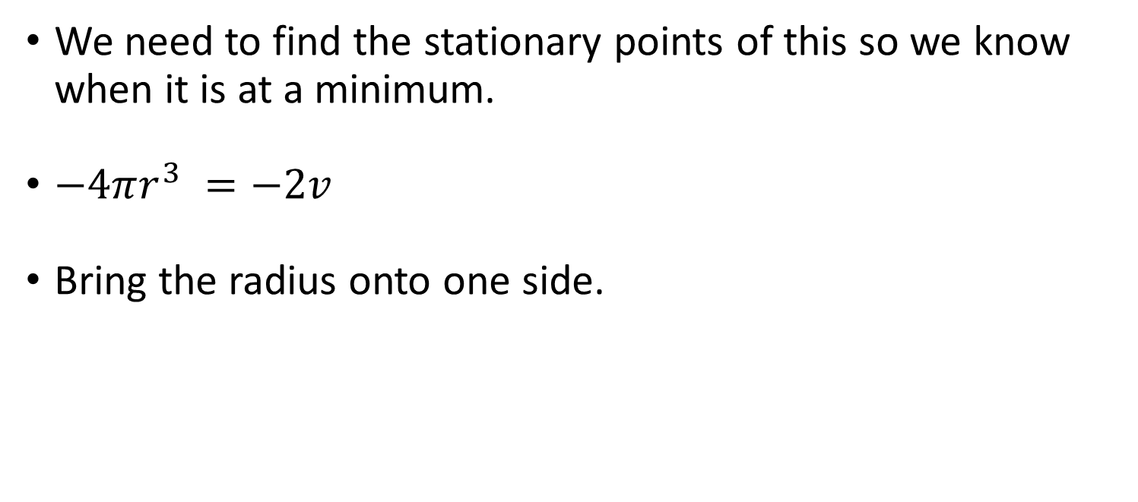
Optimisation - Can
We need to find the stationary points of this so we know when it is at a minimum.
$−4πr^{3} =−2v$
Bring the radius onto one side.

Slide 46
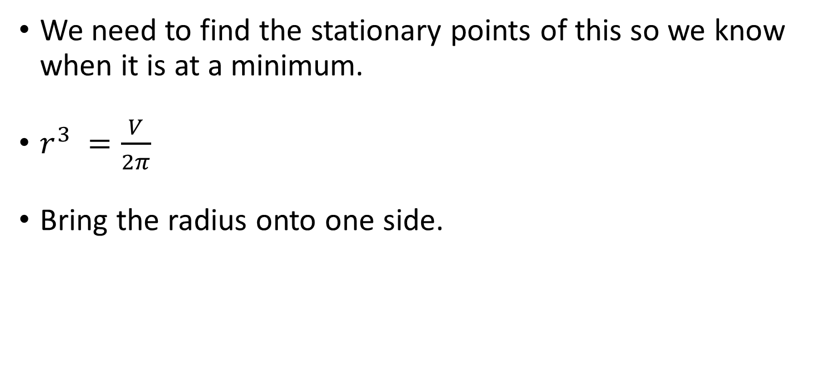
Optimisation - Can
We need to find the stationary points of this so we know when it is at a minimum.
$r^{3} =\frac{V}{2π}$
Bring the radius onto one side.

Slide 47
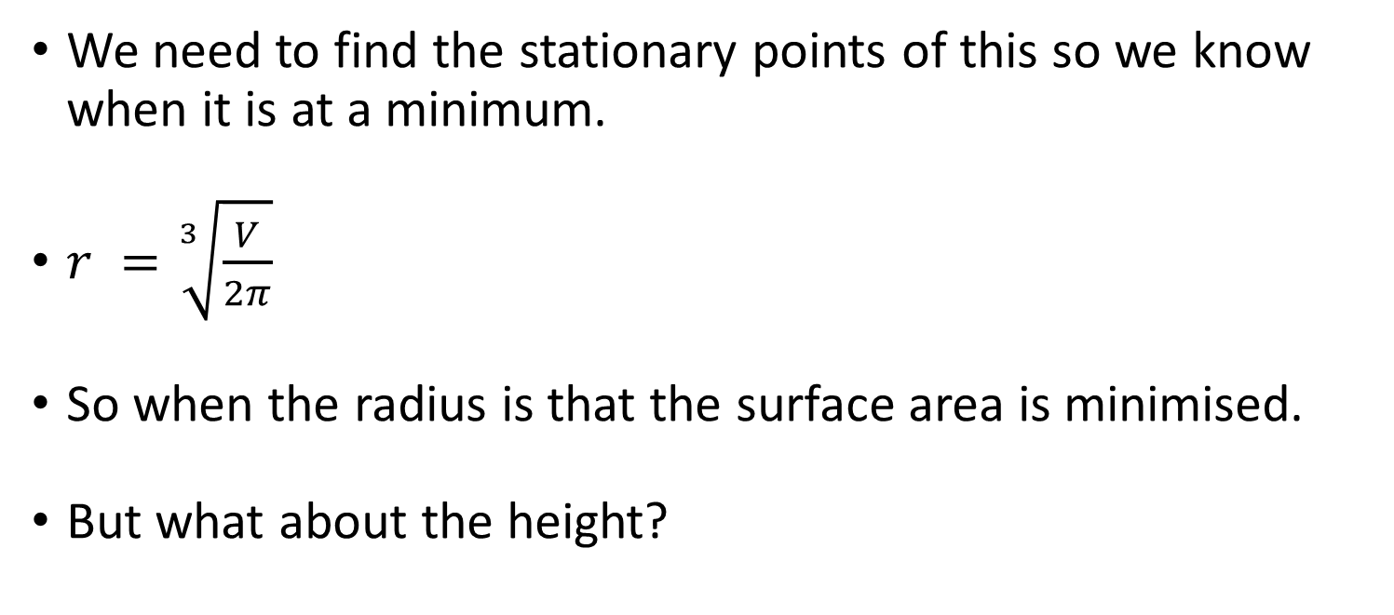
Optimisation - Can
We need to find the stationary points of this so we know when it is at a minimum.
$r =\sqrt[3]{\frac{V}{2π}}$
So when the radius is that the surface area is minimised.
But what about the height?

Slide 48
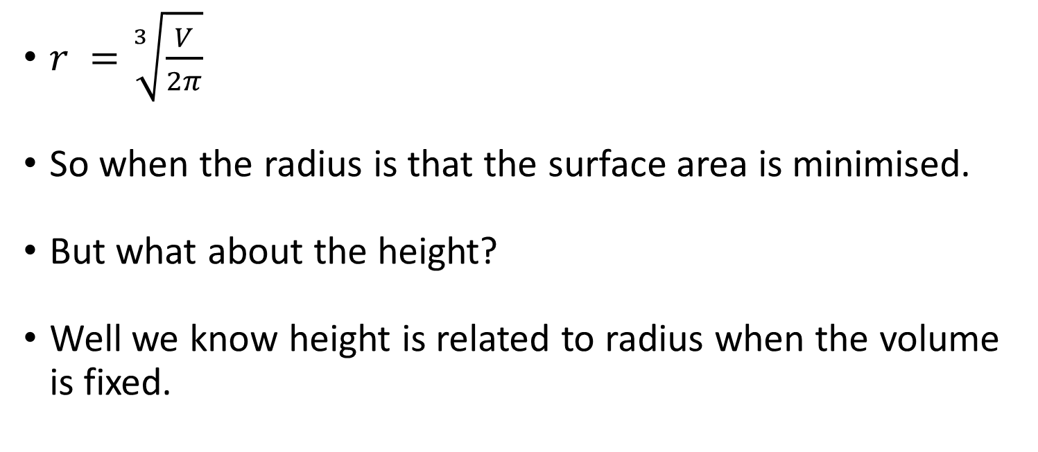
Optimisation - Can
$r =\sqrt[3]{\frac{V}{2π}}$
So when the radius is that the surface area is minimised.
But what about the height?
Well we know height is related to radius when the volume is fixed.

Slide 49
Optimisation - Can
$r =\sqrt[3]{\frac{V}{2π}}$
So when the radius is that the surface area is minimised.
But what about the height?
Well we know height is related to radius when the volume is fixed.

Slide 50
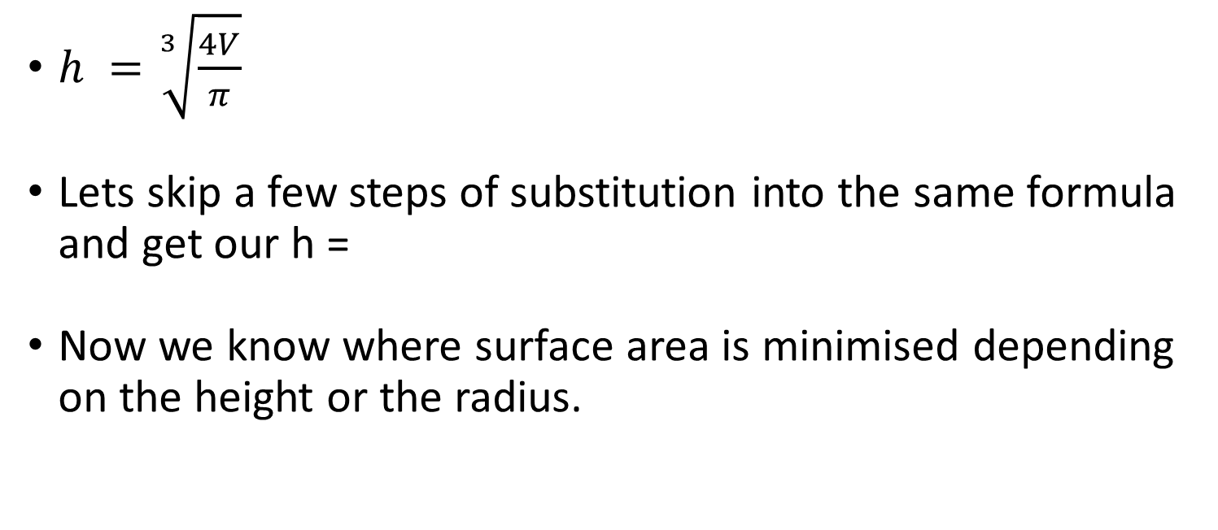
Optimisation - Can
$h =\sqrt[3]{\frac{4V}{π}}$
Lets skip a few steps of substitution into the same formula and get our h =
Now we know where surface area is minimised depending on the height or the radius.

Slide 51

Optimisation - Can
$h =\sqrt[3]{\frac{4V}{π}}$ and $r =\sqrt[3]{\frac{V}{2π}}$
So how do these relate to each other?
$\frac{h}{r} =\frac{\sqrt[3]{\frac{4V}{π}}}{\sqrt[3]{\frac{V}{2π}}}$

Slide 52

Optimisation - Can
$h =\sqrt[3]{\frac{4V}{π}}$ and $r =\sqrt[3]{\frac{V}{2π}}$
So how do these relate to each other?
$\frac{h}{r} =\frac{\sqrt[3]{\frac{4V}{π}}}{\sqrt[3]{\frac{V}{2π}}}=2$

Slide 53
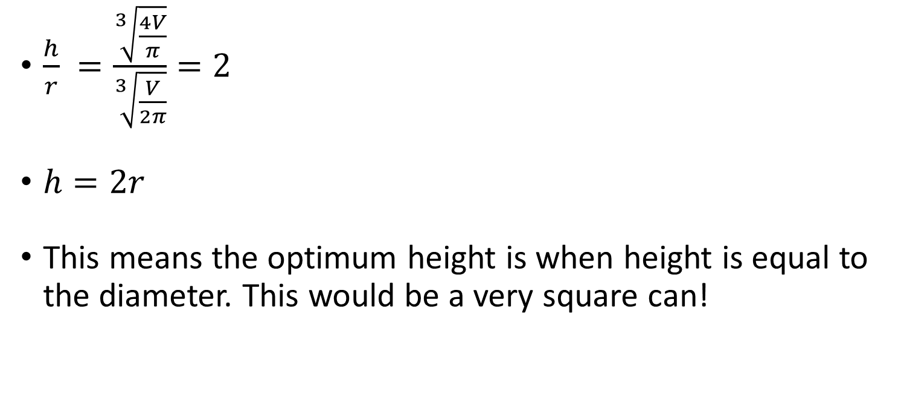
Optimisation - Can
$\frac{h}{r} =\frac{\sqrt[3]{\frac{4V}{π}}}{\sqrt[3]{\frac{V}{2π}}}=2$
$h=2r$
This means the optimum height is when height is equal to the diameter. This would be a very square can!

Slide 54
Optimisation
That was a classic example of optimisation but those two variables were related to each other through another function. This makes it much easier!
It is often possible to rephrase variables in terms of the others.

Slide 55
Optimisation
We skipped some steps for the purpose of illustration of an example to make it easier but there are general steps to take.
Lets look at a fairly simple example.
f(x,y) = x² + y²

Slide 56
Optimisation
f(x,y) = x² + y²
We need to find the stationary points based on the partial derivatives.
f’(x) = 2x
f’(y) = 2y

Slide 57
Optimisation
f(x,y) = x² + y²
We need to find the stationary points based on the partial derivatives.
0 = 2x
0 = 2y

Slide 58
Optimisation
f(x,y) = x² + y²
We need to find the stationary points based on the partial derivatives.
0 = x
0 = y

Slide 59
Optimisation
f(x,y) = x² + y²
So we know that both y and x have a stationary point at 0, this makes it very easy as if you are trying to optimise it they are at the same point.
But we don’t know whether this is a maximum or a minimum, or a saddle.

Slide 60
Optimisation
f(x,y) = x² + y²
To do this we need to use the second order derivatives.
f’’x = 2
f’’y = 2
What about the derivative of y in respect to x or f’’x,y?

Slide 61
Optimisation
What about the derivative of y in respect to x or f’’x,y?
When doing second order partial derivatives we have to differentiate the first order differentials in respect to both y and x.
This leads to four combinations
f_{xx}’’, f_{yy}’’, f_{xy}’’, f_{yx}’’ however f_{xy}’’=f_{yx}’’ so only 3 combinations.

Slide 62
Optimisation
f(x,y) = x² + y²
To do this we need to use the second order derivatives.
f’’x = 2
f’’y = 2
f’x = 2x + 0y, f’’x,y = 0 + 0y = f’’x,y = 0

Slide 63
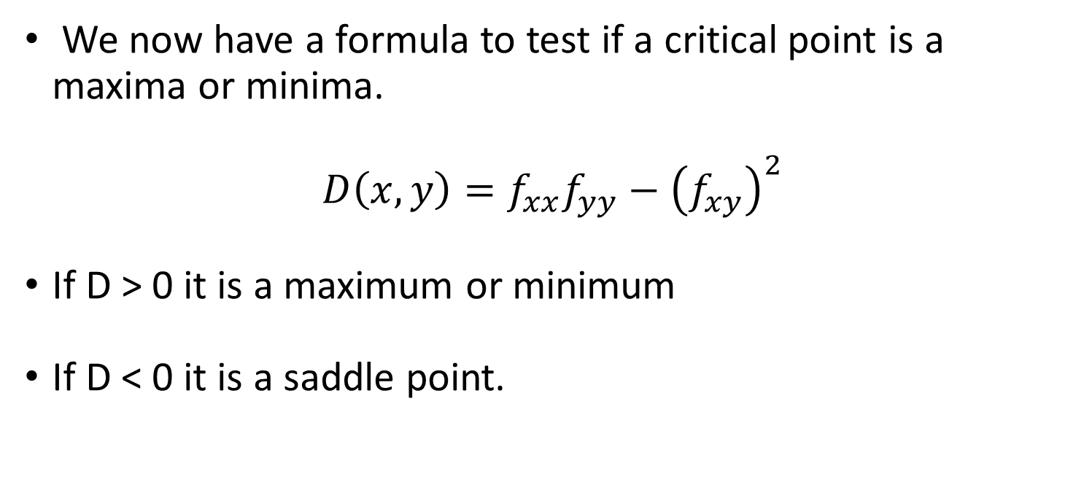
Optimisation
We now have a formula to test if a critical point is a maxima or minima.
$$D\left(x,y\right)=f_{xx}f_{yy}−{\left(f_{xy}\right)}^{2}$$
If D > 0 it is a maximum or minimum
If D < 0 it is a saddle point.

Slide 64
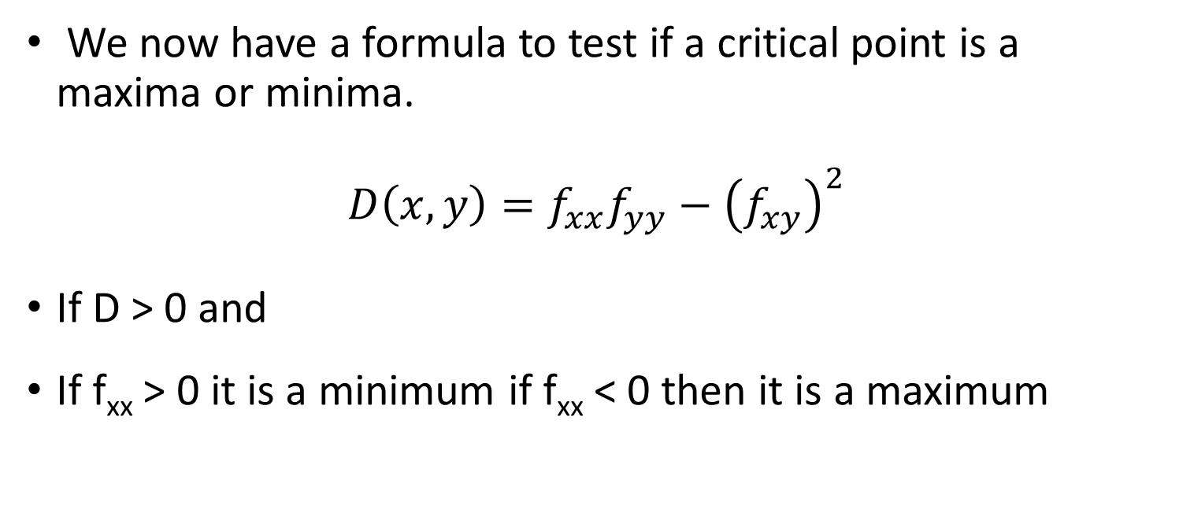
Optimisation
We now have a formula to test if a critical point is a maxima or minima.
$$D\left(x,y\right)=f_{xx}f_{yy}−{\left(f_{xy}\right)}^{2}$$
If D > 0 and
If f_{xx} > 0 it is a minimum if f_{xx} < 0 then it is a maximum

Slide 65

Optimisation
$$D\left(x,y\right)=f_{xx}f_{yy}−{\left(f_{xy}\right)}^{2}$$
So let’s try it with our critical points of D(0,0)

Slide 66

Optimisation
$$D\left(x,y\right)=2 ×2 − {\left(0\right)}^{2}$$
So let’s try it with our critical points of D(0,0)

Slide 67

Optimisation
$$D\left(x,y\right)=4$$
So let’s try it with our critical points of D(0,0)

Slide 68
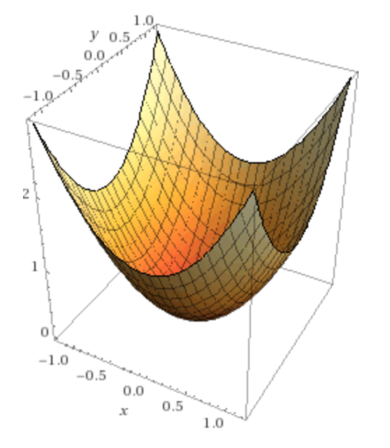
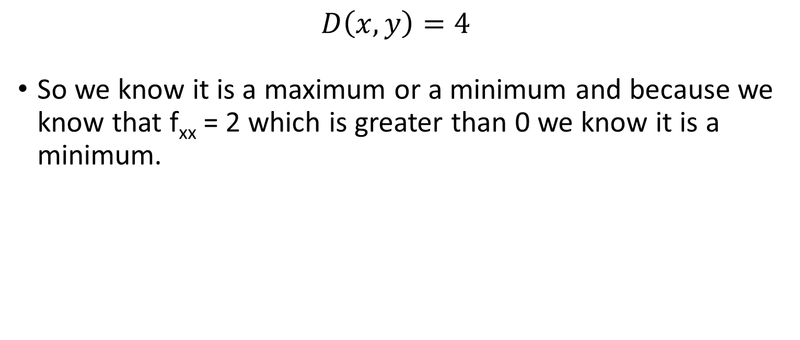
Optimisation
$$D\left(x,y\right)=4$$
So we know it is a maximum or a minimum and because we know that f_{xx} = 2 which is greater than 0 we know it is a minimum.

Slide 69
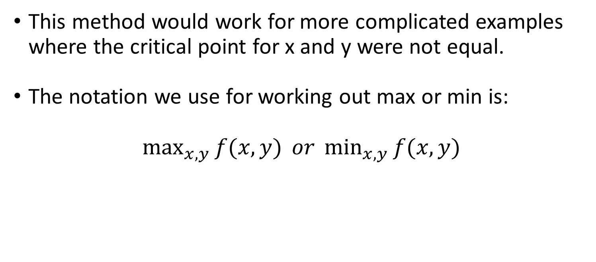
Optimisation
This method would work for more complicated examples where the critical point for x and y were not equal.
The notation we use for working out max or min is:
$\max_{x,y}{f(x,y)} or \min_{x,y}{f(x,y)}$

Slide 70
Constrained Optimisation
Most optimisation is in reality constrained within certain parameters.
If we look at our can example it would be constrained in that we need to find the smallest surface area where the volume has to equal 330ml.

Slide 71
Constrained Optimisation
Nearly everything in the real world, scientific or your life is actually an optimisation problem.
When you choose a job you want to maximise your income and enjoyment of your job, maybe you have a minimum salary.
If you buy an object you have a budget and maximise the quality/ quantity you get.

Slide 72

Constrained Optimisation
We phrase constrained optimisation like this:
$$\max_{x,y}{f\left(x,y\right)}$$
$$subject to g\left(x,y\right)≥0$$

Slide 73
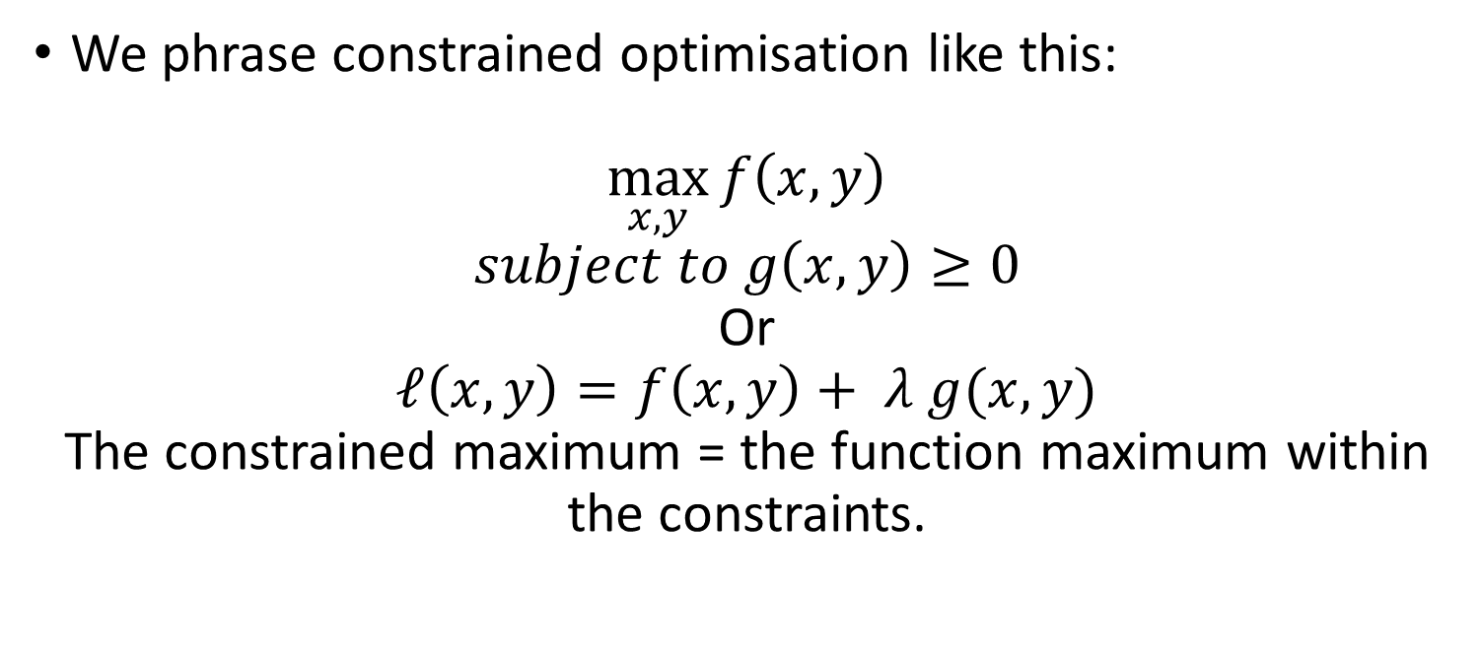
Constrained Optimisation
We phrase constrained optimisation like this:
$$\max_{x,y}{f\left(x,y\right)}$$
$$subject to g\left(x,y\right)≥0$$
Or
$$ℓ\left(x,y\right)=f\left(x,y\right)+ λ g(x,y)$$
The constrained maximum = the function maximum within the constraints.

Slide 74
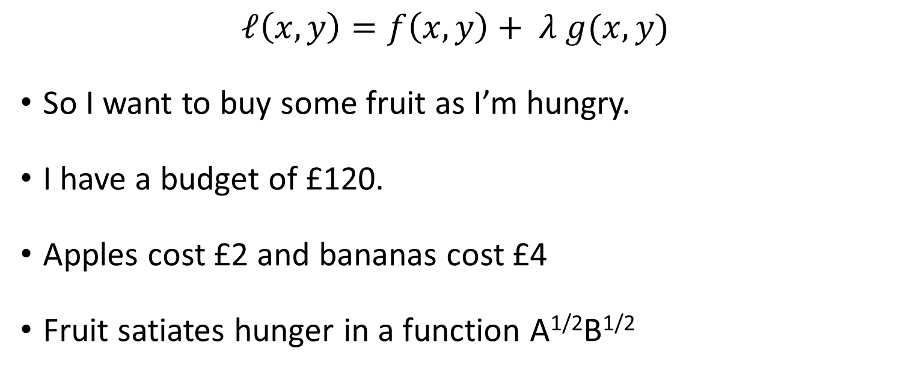
Constrained Optimisation
$$ℓ\left(x,y\right)=f\left(x,y\right)+ λ g(x,y)$$
So I want to buy some fruit as I’m hungry.
I have a budget of £120.
Apples cost £2 and bananas cost £4
Fruit satiates hunger in a function A^{1/2}B^{1/2}

Slide 75
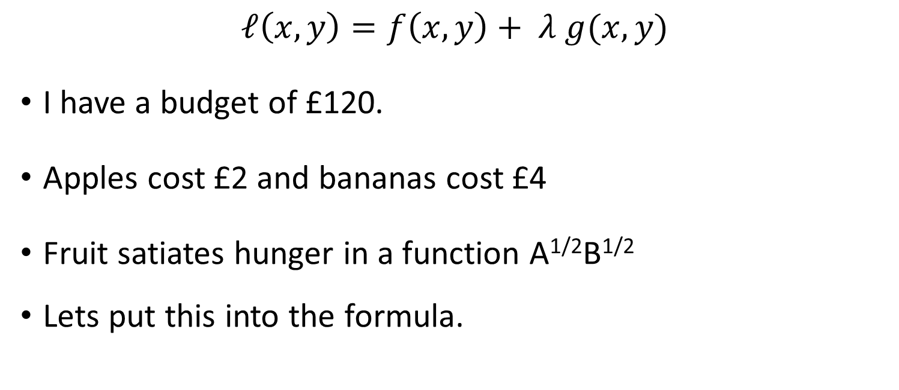
Constrained Optimisation
$$ℓ\left(x,y\right)=f\left(x,y\right)+ λ g(x,y)$$
I have a budget of £120.
Apples cost £2 and bananas cost £4
Fruit satiates hunger in a function A^{1/2}B^{1/2}
Lets put this into the formula.

Slide 76
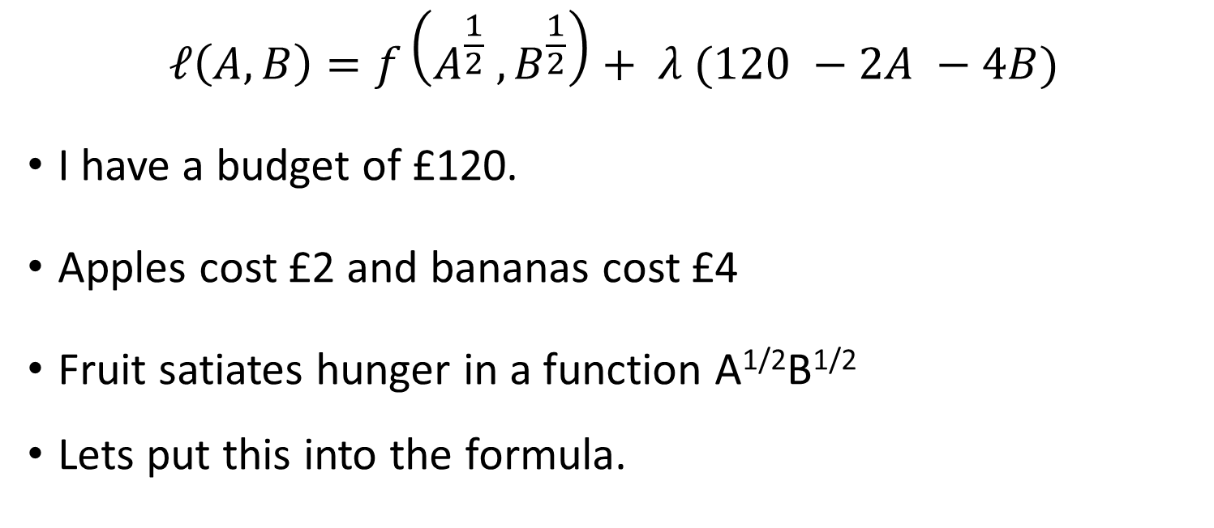
Constrained Optimisation
$$ℓ\left(A,B\right)=f\left(A^{\frac{1}{2}} ,B^{\frac{1}{2}}\right)+ λ (120 −2A −4B)$$
I have a budget of £120.
Apples cost £2 and bananas cost £4
Fruit satiates hunger in a function A^{1/2}B^{1/2}
Lets put this into the formula.

Slide 77

Constrained Optimisation
$$ℓ\left(A,B\right)=f\left(A^{\frac{1}{2}} ,B^{\frac{1}{2}}\right)+ λ (120 −2A −4B)$$
Now differentiate for A and B

Slide 78

Constrained Optimisation
$$ℓA^{′\left(A,B\right)}=\frac{1}{2}A^{−\frac{1}{2}}B^{\frac{1}{2}}−2λ$$
Now differentiate for A and B

Slide 79

Constrained Optimisation
$$ℓA^{′}(A,B)=\frac{1}{2}A^{−\frac{1}{2}}B^{\frac{1}{2}}−2λ$$
$$ℓB^{′}(A,B)=\frac{1}{2}A^{\frac{1}{2}}B^{−\frac{1}{2}}−4λ$$
Now differentiate for A and B

Slide 80

Constrained Optimisation
$$ℓA^{′}(A,B)=\frac{1}{2}A^{−\frac{1}{2}}B^{\frac{1}{2}}−2λ$$
$$ℓB^{′}(A,B)=\frac{1}{2}A^{\frac{1}{2}}B^{−\frac{1}{2}}−4λ$$
Now solve these for lambda

Slide 81

Constrained Optimisation
$$2λ= \frac{1}{2}A^{−\frac{1}{2}}B^{\frac{1}{2}}$$
$$4λ= \frac{1}{2}A^{\frac{1}{2}}B^{−\frac{1}{2}}$$
Now solve these for lambda

Slide 82

Constrained Optimisation
$$λ=\frac{A^{−\frac{1}{2}}B^{\frac{1}{2}}}{4}$$
$$λ=\frac{A^{\frac{1}{2}}B^{−\frac{1}{2}}}{8}$$
Now solve these for lambda

Slide 83

Constrained Optimisation
$$λ=\frac{A^{−\frac{1}{2}}B^{\frac{1}{2}}}{4}$$
$$λ=\frac{A^{\frac{1}{2}}B^{−\frac{1}{2}}}{8}$$
Set the equations to be equal to each other so we can equate A to B.

Slide 84

Constrained Optimisation
$$\frac{A^{\frac{1}{2}}B^{−\frac{1}{2}}}{4}=\frac{A^{−\frac{1}{2}}B^{\frac{1}{2}}}{8}$$
Set the equations to be equal to each other so we can equate A to B.

Slide 85

Constrained Optimisation
$$\frac{A^{\frac{1}{2}}B^{−\frac{1}{2}}}{4}=\frac{A^{−\frac{1}{2}}B^{\frac{1}{2}}}{8}$$
Simplify it

Slide 86

Constrained Optimisation
$$A^{\frac{1}{2}}B^{−\frac{1}{2}} =\frac{{4A}^{−\frac{1}{2}}B^{\frac{1}{2}}}{8}$$
Simplify it
Times both sides by 4

Slide 87

Constrained Optimisation
$$A^{\frac{1}{2}}B =\frac{{4A}^{−\frac{1}{2}}}{8}$$
Simplify it
Divide both sides by B^{-1/2}

Slide 88

Constrained Optimisation
$$B =\frac{4A}{8}$$
Simplify it
Divide both sides by A^{-1/2}

Slide 89

Constrained Optimisation
$$A =2B$$
Simplify it

Slide 90

Constrained Optimisation
$$A =2B$$
What we can take from this is that at an optimal point to fill ourselves we should have twice the number of apples as bananas.
This was pretty obvious from the cost of bananas being double.

Slide 91

Constrained Optimisation
$$A =2B$$
What we can take from this is that at an optimal point to fill ourselves we should have twice the number of apples as bananas.
This was pretty obvious from the cost of bananas being double. But we needed this for the simultaneous equation.

Slide 92

Constrained Optimisation
$$A =2B$$
$$2A+4B=120$$
Fill in our money constraint.

Slide 93

Constrained Optimisation
$$A =2B$$
$$2A+4B=120$$
Now solve it like a simultaneous equation.

Slide 94

Constrained Optimisation
$$A =2B$$
$$2(2B)+4B=120$$
Now solve it like a simultaneous equation.

Slide 95

Constrained Optimisation
$$A =2B$$
$$8B=120$$
Now solve it like a simultaneous equation.

Slide 96

Constrained Optimisation
$$A =2B$$
$$B=15$$
Now solve it like a simultaneous equation.

Slide 97

Constrained Optimisation
$$A =2B$$
$$B=15$$
Ok so we know we want 15 bananas which means we want 30 apples!

Slide 98

Constrained Optimisation
$$A =2B$$
$$B=15$$
Ok so we know we want 15 bananas which means we want 30 apples!
But does it satisfy our income requirements?
$$£2 ×30+£4 ×15=£120$$

Slide 99

Constrained Optimisation
Lambda is what we call a lagrange multiplier and with it we make the lagrange function which is the optimised function f with the constraints of the function g.
$$ℓ\left(x,y\right)=f\left(x,y\right)+ λ g(x,y)$$

Slide 100

Constrained Optimisation
If we are trying to minimise not maximise a function then instead we just subtract the constrained function
$$ℓ\left(x,y\right)=f\left(x,y\right)− λ g(x,y)$$
We then follow the same steps!

